Slide 1
Volcafe Ltd v CSAV
Specific advice should always be obtained before relying on any aspect of the content of this presentation or associated materials.

Slide 2
Format of todays session
Factual background
Legal framework
Analysis of decision
Effect on New Zealand

Slide 3
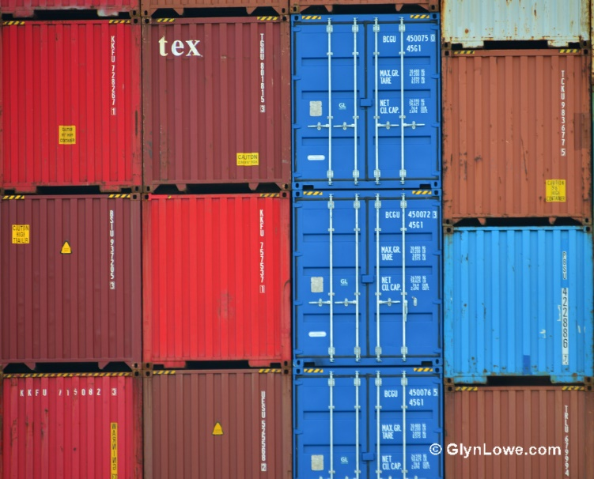
Factual Background
The appellants Volcafe Limited & Others contracted the respondent Compania Sud Americana De Vapores SA to transport 20 container loads of coffee beans from Columbia to Germany.
Bills of lading were subject to English law and incorporated the Hague Visby Rules.
They were on less than full, full container load terms.
The respondent was responsible for loading.
Coffee beans are hygroscopic.
Common practise to transport in both ventilated and unventilated containers.
Precautions were to be taken when in unventilated containers.
18 of the 20 containers were found to have water damage to the coffee when unloaded.
Notes:
Cof

Slide 4
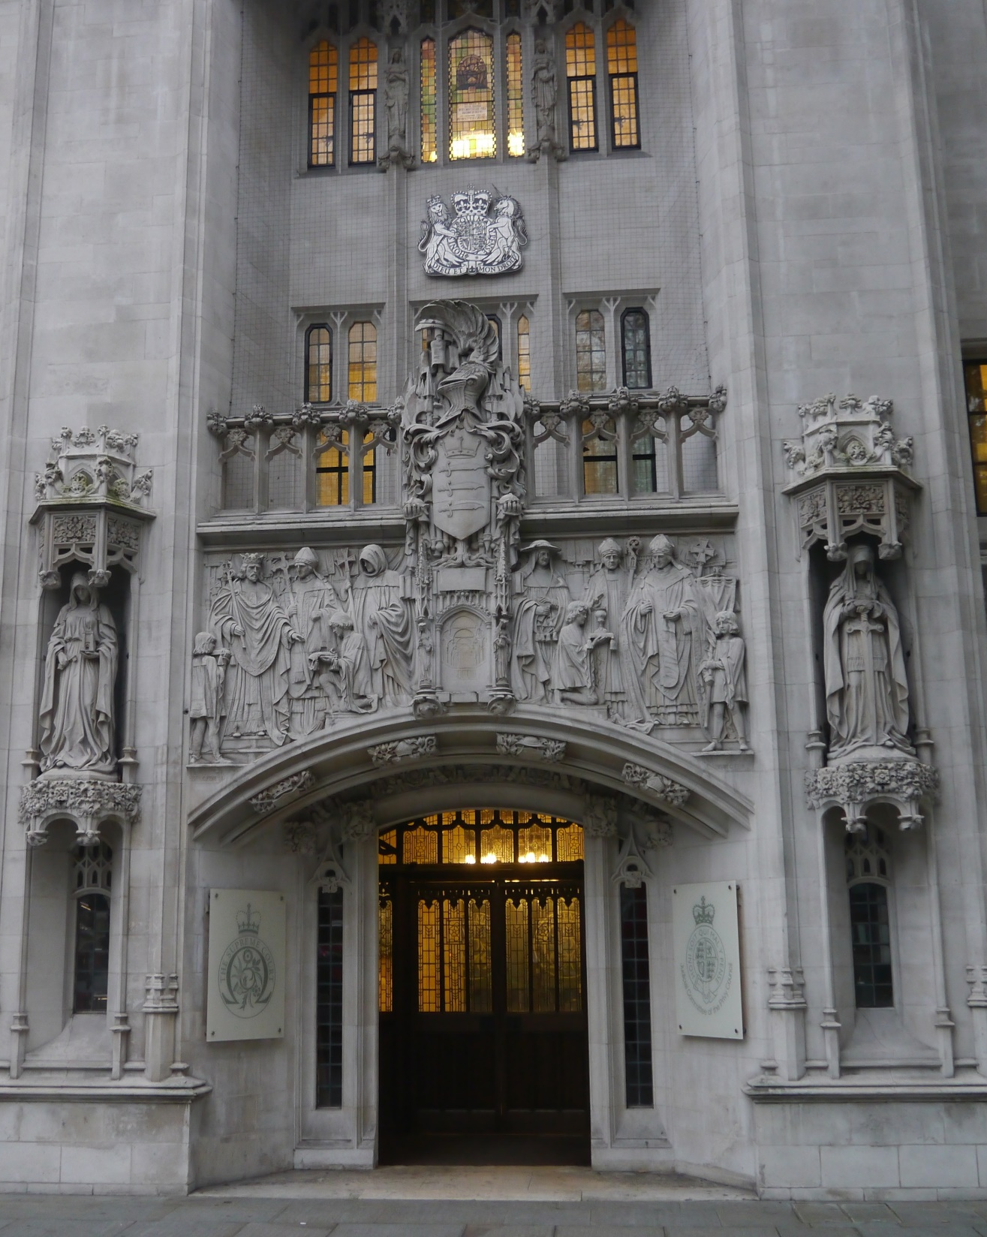
Legal Background – Common law position
Brief but important overview of the legal background.
Delivery by sea is a bailment for reward
A bailee of goods is not an insurer – Reasonable care
Subject to the above the bailee carries the legal burden of proving the absence of negligence.

Slide 5
Hague Visby Rules
Article II
The rules apply to every contract for the carriage of goods by sea, this includes loading, handling, stowage, carriage, custody, care, and discharge of goods.
Article III.2
Imposes a obligation on the carrier to properly and carefully load, handle, stow, carry, keep, care for, and discharge the goods carried.
Article IV.2 (m)
Neither the carrier nor the ship shall be responsible for loss or damage arising out of an inherent defect, quality, or vice of the goods.

Slide 6
Burden of Proof Issues
Does the cargo-owner bear the legal burden of proving a breach of Article III.2 (duty of care obligation) or once the loss is proved by the owner is it for the carrier to prove compliance?
Once the carrier proves that there is an inherent vice, does the cargo owner need to prove negligence of the carrier or is it for the carrier to show that it was not its actions which brought out the inherent vice.

Slide 7
Article III.2 – Respondents Position
Hague Visby Rules constitute a complete code governing the care of the cargo.
International conventions like the Hague Visby Rules should not be construed in light of particular features English or other domestic law.
By imposing an obligation to take reasonable care this displaces the English law rule about burden of proof as “he who asserts must prove”.

Slide 8
Court’s view on respondents points 1 & 2
In this case the Hague Visby Rules only applied by virtue of their contractual incorporation in the bill of sale.
The rules are a complete code only for what they cover.
It is a general principal of private international law that the laws of evidence and procedure vary between jurisdictions and are applied by the forum the proceedings are raised in.
Common law principals regarding burden of proving negligence are not purely domestic.
Scotland applies a similar burden of proof
France applies an even stricter test of: Damage = Breach unless proved otherwise.

Slide 9
Court’s view on respondents point 3
Based on a misconception:
Common law bailee has a strict obligation to redeliver in the same conditions as received.
As a result the qualified obligation has a different duty and therefore burden.

Slide 10
Further comments by the court
The negligent acts covered by Article IV are commonly accepted as to be proved by the carrier.
It would be incoherent for the law to require the owner to prove the same facts under Article III.2 as the carrier under Article IV.
If damage occurs then it is for the carrier to show that the loss or damage occurred without a breach of the duty of care or under one of the exceptions.

Slide 11
Burden of Proof: Article IV.2(m)
Starting point is: Exceptions do not protect the carrier from the part of the damage which could have alleviated by the exercise of due care Notara v Henderson
Exception in respect to the loss only so far as the loss could not be avoided by the exercise of reasonable case.
If precautions could and should have been taken to prevent the inherent characteristic from resulting in damage then the characteristic is not inherent vice.
To rely on inherent vice the carrier must show that they took reasonable care or that whatever reasonable steps might have been taken would have failed anyway.

Slide 12
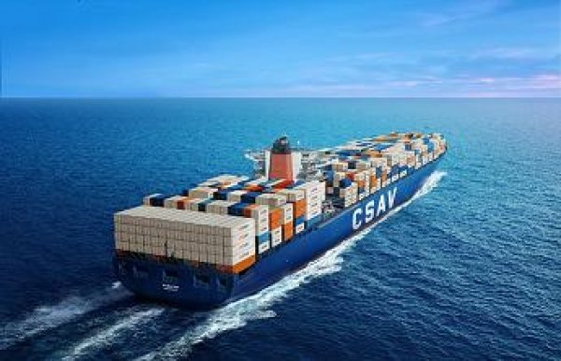
Summary
Burden of proof is to lie with the carrier for both articles.
This provides consistency for which party proves the same facts.
Carrier in the best position to prove.

Slide 13
Application in New Zealand.
Decision goes against the New Zealand authority of Shaw, Savill & Albion Co Limited v R Powley which held that once an inherent defect was shown to exist it was up to the owner to prove negligence.
I have not found any case where New Zealand has addressed this in some time.

