Slide 1
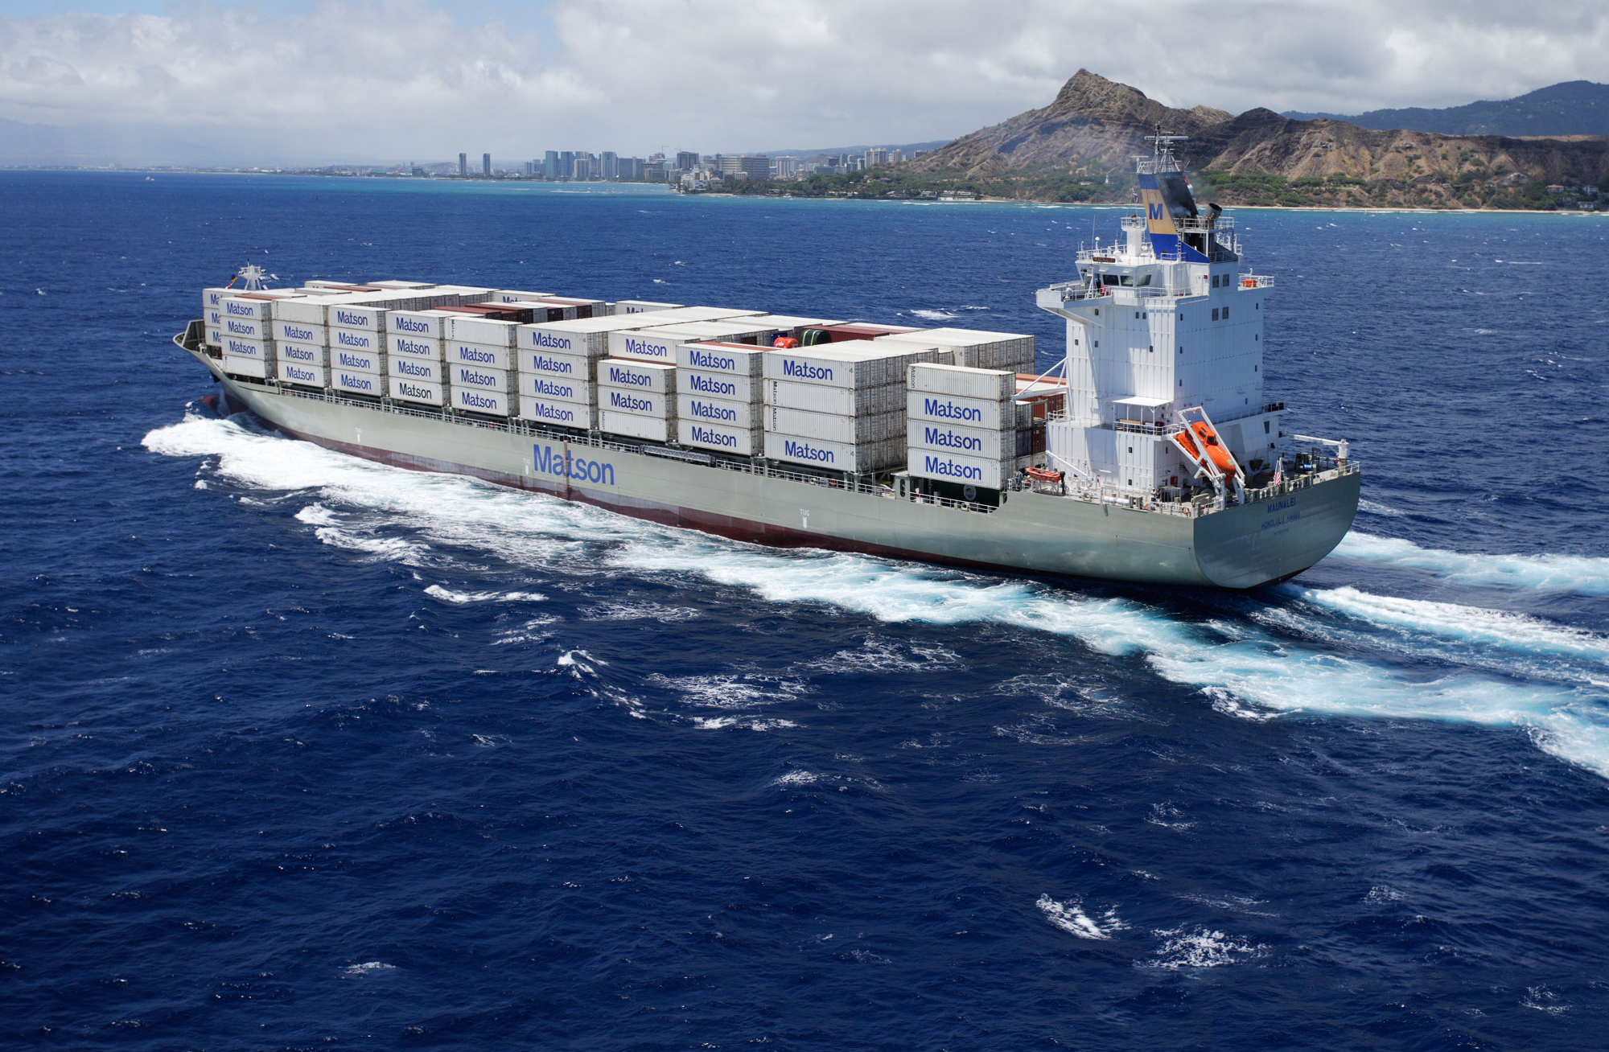
Collision or collusion?
Some aspects of competition law in SW Pacific liner shipping
11 April 2019

Slide 2
Scope
Regional scene-setter:
Participants/ships/routes/collaborative arrangements
Some regional regimes
New Zealand - pre August 2017
Cook Islands
American Samoa
Australia
Licenses etc.
New Zealand - post August 2019

Slide 3
Lines, ships and routes
0
American Samoa, Australia, Cook Islands, Fiji, Nauru, Niue, NZ, Samoa, Solomon Islands, Tahiti, Tonga, Tuvalu, Vanuatu
American Samoa, Australia, Fiji, Nauru, Norfolk Island, NZ, Samoa, Solomon Islands, Vanuatu
American Samoa, Australia, Cook Islands, Fiji, NZ, PNG, Samoa, Tonga
American Samoa, Australia, Cook Islands, Fiji, New Caledonia, Norfolk Island, NZ, Samoa, Solomon Islands, Tahiti, Tonga, Tuvalu, Vanuatu, Wallis & Futuna
American Samoa, Australia, New Caledonia, NZ, PNG, Samoa, Solomon Islands, Tonga, Wallis & Futuna

Slide 4
Collaboration?
Joint ventures
Cargo / revenue pooling
Vessel sharing
Connecting carrier agreements
Slot charters
Equipment inter-change
Discussion agreement
FMC registered agreements

Slide 5
New Zealand - pre August 2017
Section 44, Commerce Act 1986
(2) Nothing in [Part 2 of the Act] applies—
(a) to the entering into of a contract, or arrangement, or arriving at an understanding in so far as it contains a provision exclusively for the carriage of goods by sea from a place in New Zealand to a place outside New Zealand or from a place outside New Zealand to a place in New Zealand; or
(b) to any act done to give effect to a provision of a contract, arrangement, or understanding referred to in paragraph (a).
(3) For the purposes of subsection (2), a provision of a contract, arrangement, or understanding is not a provision exclusively for the carriage of goods by sea if it relates to the carriage of goods to or from a ship or the loading or unloading of a ship.

Slide 6
New Zealand – Part 2 Commerce Act 1986
Section 27:
Contracts , arrangements , or understandings substantially lessening competition prohibited
Section 28:
Covenants substantially lessening competition prohibited
Section 29:
Contracts, arrangements, or understandings containing exclusionary provisions prohibited
Section 30:
Certain provisions of agreements with respect to prices deemed to substantially lessen competition
Section 36
Taking advantage of market power (formerly “Use of dominant position in a market”)

Slide 7
New Zealand – Shipping Act 1987
Section 4:
Unfair practices justifying use of Minister's powers to initiate investigations and issue directions
Section 5:
Minister may investigate suspected unfair practise
Section 7
Minister may issue directions to carriers engaging in unfair practises
Section 14
Application of other Acts
“Nothing in Parts 2 and 4 of the Commerce Act 1986 shall apply to outwards shipping.”
NB:
Outwards shipping only;
No individual rights of action to enforce

Slide 8
Cook Islands
Part III, International Shipping Act 1999
Section 4:
Covenants substantially lessening competition prohibited
Section 5
Agreements containing exclusionary provisions prohibited
Section 6
Certain provisions of agreements with respect to prices deemed to substantially lessen competition
Section 7
Contracts, arrangements, or understandings substantially lessening competition prohibited
Section 8
Unfair practices
NB Cook Islands National Line Agency Ltd v Cook Islands Shipping Corporation Ltd [2003] CKCA 9, per Casey and Williams JJA

Slide 9
American Samoa
46 U.S. Code [Shipping Act 1984] § 40301. Application
(a)Ocean Agreements.—This part applies to an agreement between or among ocean common carriers to—
(1) discuss, fix, or regulate transportation rates, including through rates, cargo space accommodations, and other conditions of service;
(2) pool or apportion traffic, revenues, earnings, or losses;
(3) allot ports or regulate the number and character of voyages between ports;
(4) regulate the volume or character of cargo or passenger traffic to be carried;
(5) engage in an exclusive, preferential, or cooperative working arrangement between themselves or with a marine terminal operator;
(6) control, regulate, or prevent competition in international ocean transportation; or
(7) discuss and agree on any matter related to a service contract.
46 U.S. Code § 40307. Exemption from antitrust laws
(a)In General.—The antitrust laws do not apply to—
(1) an agreement (including an assessment agreement) that has been filed and is effective under this chapter;

Slide 10
Australia
Subsection 10.01A, Division 1, Part X, Competition and Consumer Act 2010
This Part sets up a system for regulating international liner cargo shipping services.
• The main components of that system are as follows:
(a) registration of conference agreements;
(b) regulation of non‑conference ocean carriers with substantial market power;
(c) regulation of unfair pricing practices;
(d) registration of agents of ocean carriers.
• The parties to a conference agreement relating to international liner cargo shipping services may apply for the registration of the agreement.
• If the conference agreement is registered, the parties will be given partial and conditional exemptions from:
(a) sections 45AF, 45AG, 45AJ and 45AK (cartel conduct); and
(b) section 45 (contracts etc. that restrict dealings or affect competition); and
(c) section 47 (exclusive dealing).
• The parties to a registered conference agreement are required to negotiate with, and provide information to, representative shipper bodies.
• The Commission may investigate whether grounds exist for the Minister to deregister a conference agreement.
• The main ground for deregistration is a breach by the parties to the agreement of requirements imposed on them by this Part.

Slide 11
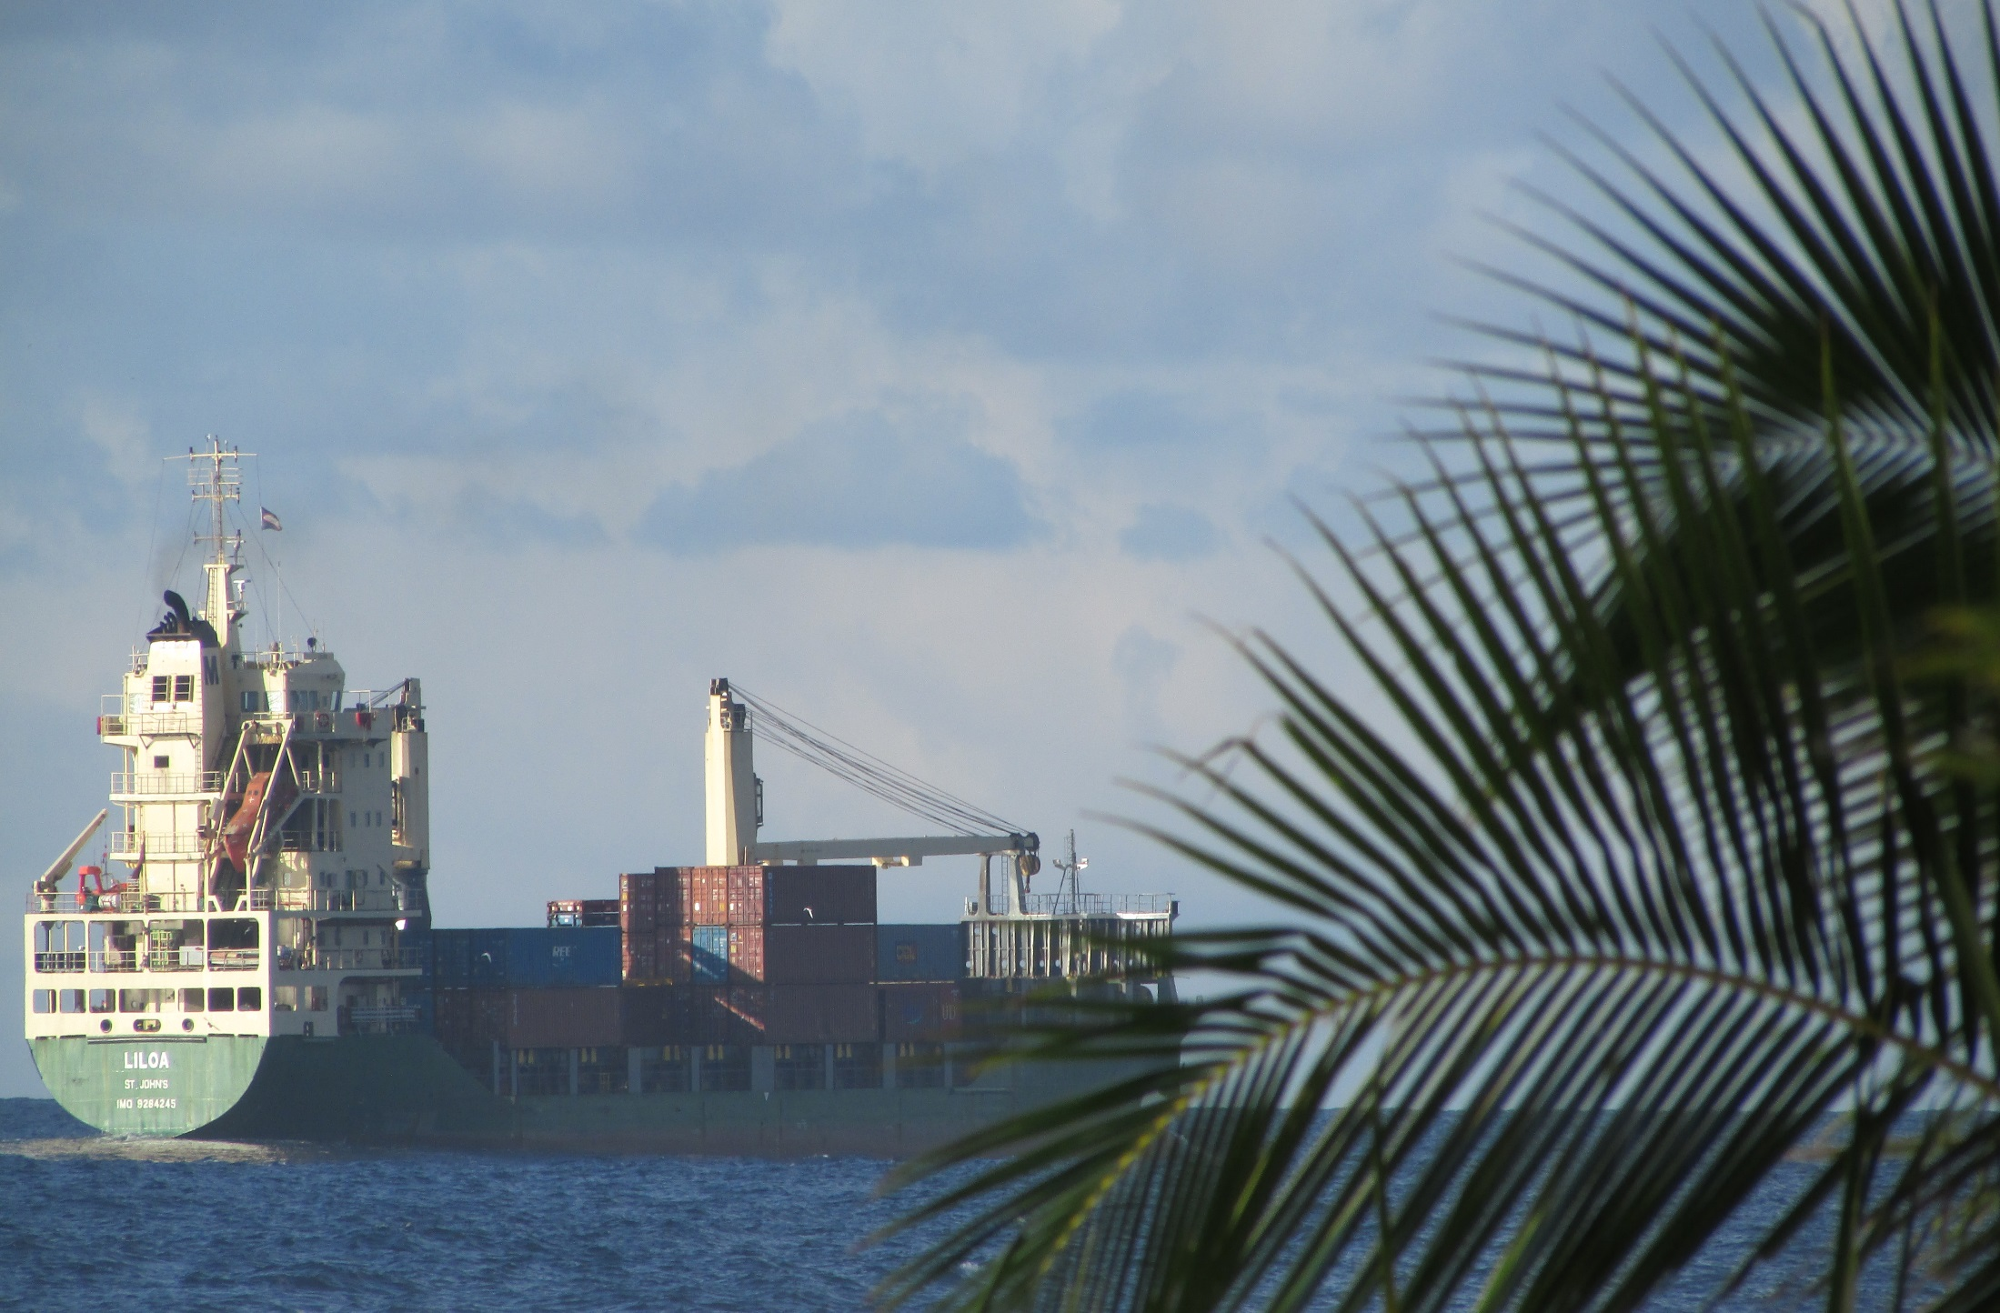
Licences etc.
International Shipping Approvals (Cook Islands, per Shipping Licence Ordinance 1963)
Shipping Service Agreements (Niue, Nauru, Wallis and Futuna (?))
Central Pacific Shipping Commission (Kiribati, Marshall Islands, Nauru and Tuvalu)

Slide 12
In practise?
“a provision exclusively for the carriage of goods by sea”
Freight rates?
Freight rebates – shared and “secret”?
BAF/CAF/CABAF?
THCs?
Documents?
Security fees?
Trade lane allocations?
Tenders?
See Re Fonterra Co-operative Dairy Group Limited [2012] NZCC 7

Slide 13
New Zealand - post August 2019
Commerce (Cartels and Other Matters) Amendment Act 2017:
New section 2(1) definition:
“international liner shipping service”
means a service exclusively for the carriage of goods by sea from a place in New Zealand to a place outside New Zealand, or from a place outside New Zealand to a place in New Zealand, that—
(i) operates at regular intervals on a fixed route or fixed routes in accordance with an advertised schedule; and
(ii) is supplied, as its capacity allows, to any paying customer; but
(b) excludes a service for the carriage of goods to or from a ship or the loading or unloading of a ship

Slide 14
New Zealand - post August 2019 (contd.)
New section 44A - Exceptions in relation to international liner shipping services
[Nothing in sections 27(1), 27(2), 27(4), 30(a) or 30(b) if, at the time of the relevant proscribed or presumptively anti-competitive conduct], the circumstances in subsection (6) apply.
…
(6) The circumstances are that—
(a) the person and all other parties to the contract, arrangement, or understanding that contains the provision are supplying an international liner shipping service in co-operation with each other; and
(b) the co-operation improves the service supplied to owners or consignors of goods carried at sea; and
(c) the provision relates to—
(i) a specified activity carried out for the purposes of the co-operation; or
(ii) an activity ancillary to a specified activity that is reasonably necessary for the purposes of the co-operation.
…
(8) In this section,—
specified activity means any of the following:
(a) the co-ordination of schedules and the determination of port calls:
(b) the exchange, sale, hire, or lease (including the sublease) of space on a ship:
(c) the pooling of ships to operate a network:
(d) the sharing or exchanging of equipment such as containers:
(e) capacity adjustments in response to fluctuations in supply and demand for international liner shipping services.

Slide 15
New Zealand - post August 2019 (contd.)
New section 44B - Further exception in relation to international liner shipping services (price fixing in relation to space on ship)
(1) Nothing in section 30(a) applies to a person in relation to a cartel provision that has the effect, or likely effect, of price fixing if, at the time of entering into or arriving at the contract, arrangement, or understanding that contains the provision, the circumstances in subsection (3) apply.
(2) Nothing in section 30(b) applies to a person in relation to a cartel provision that has the effect, or likely effect, of price fixing if, at the time of giving effect to the provision, the circumstances in subsection (3) apply.
(3) The circumstances are that—
(a) the person and all other parties to the contract, arrangement, or understanding that contains the cartel provision are supplying an international liner shipping service in co-operation with each other; and
(b) the co-operation improves the service supplied to owners or consignors of goods carried at sea; and
(c) the provision relates to the exchange, sale, hire, or lease (including the sublease) of space on a ship between the person and 1 or more parties to the contract, arrangement, or understanding; and
(d) the exchange, sale, hire, or lease (including the sublease) is carried out for the purposes of the co-operation.

Slide 16
New Zealand - post August 2019 (contd.)
Sections 33 and 34, Commerce (Cartels and Other Matters) Amendment Act 2017
33 Amendments to Shipping Act 1987
(1) This section amends the Shipping Act 1987.
….
(3) Repeal parts 1 and 3.
34 Consequential amendment to principal Act as result of amendments to Shipping Act 1987
Section 44(2) and (3) of the principal Act are repealed.

Slide 17
In practise – post August 2019?
For Non-Ratemaking Agreements:
Exempt from Part 2, Commerce Act 1986 (as amended) if:
Within the list of permitted forms of co-operation, or activities ancillary to those permitted forms of co-operation; and
Provides improved services.
For Ratemaking Agreements:
Can self-assess as non-infringing (i.e. demonstrably not for the dominant purpose of lessening competition);
Can seek Commerce Commission clearance or authorization for forms of ratemaking/pricing agreements

