Slide 1
Package Limitation for containerised cargo
AP Moller-Maersk A/S trading as Maersk Line v Kyokuyo Limited [2018] EWCA Civ 778 (The Maersk Tangier)
Presented by Yash Patel

Slide 2
Facts
Frozen tuna being shipped on The Maersk Tangier from Spain to Japan.
The containers were shipped according to Maersk T&Cs.
No bills of lading were issued; instead cargo shipped under sea waybills.
On discharge, Kyokuyo alleged Tuna was damaged; claiming ¥121 million.

Slide 3
High court
Baker J held that it did not matter that a bill of lading was not issued for the applicability of the Hague-Visby Rules. There was entitlement to demand a bill of lading and that was ruled to be sufficient.
Secondly, he held that individual tuna loins were the “packages or units” as packed in the containers and, as they were enumerated in the waybills, they were the relevant “units” for the purpose of Article IV Rule 5(a).

Slide 4
Issues at Court of appeal
Is liability limited pursuant to Article IV rule 5 of the Hague Rules or pursuant to Article IV rule 5 of the Hague-Visby Rules (whether applicable compulsorily or contractually)?
If liability is limited pursuant to Article IV rule 5 of the Hague Rules, are the relevant packages or units the containers or the individual pieces of tuna?
If liability is limited pursuant to Article IV rule 5 of the Hague-Visby Rules, are the containers deemed to be the relevant package or unit for the purposes of Article IV rule 5(c), or are the individual pieces of tuna ‘packages or units’ enumerated in the relevant document as packed in each container for the purposes of Article IV rule 5(c)?

Slide 5
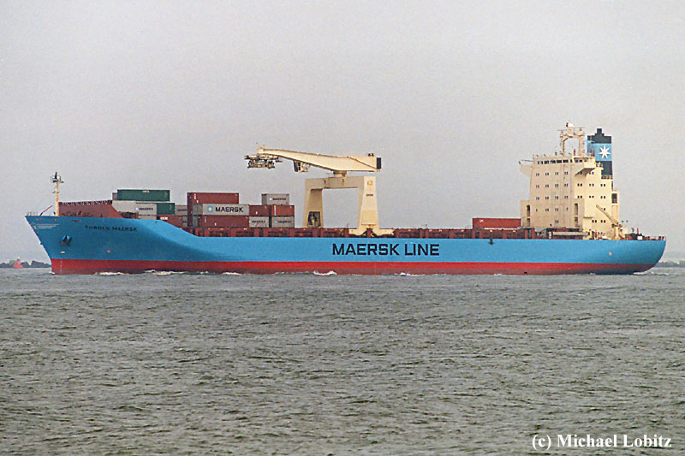
Decision on Issue 1
Flaux LJ held that it is not necessary for a bill of lading to in fact be issued; it is sufficient that the contract provided for one to be issued.
Here, there was an implied terms in the Maersk T&Cs that the shipper were entitled to demand a bill of lading. This was held to be sufficient.

Slide 6
Decision on Issue 2
The second issue became academic on the basis that the Hague-Visby Rules were held to be applicable.

Slide 7
Decision on Issue 3
The Court of Appeal held that enumeration requires no more than specifying the number of packages or units in words or numbers; there is no requirement for a further description as to how the packages or units are actually packed.
On the facts, the sea waybill had clearly quantified the number of tuna pieces.

Slide 8
But what about el Greco in Australia?
The Court in El Greco held that, the inclusion of the words “as packed” required the description in the bill to not only state the number of packages or units, but also how they had been packed, whether as separate items or consolidated into packages.
As already discussed, the UK Court of Appeal declined to follow this.
Current Australian law likely to be overturned given the opportunity.

